Slide 1
CSE 111 Project
Michael Issa & Alexander Fudala

Slide 2



Environment/Language
For our database we will use PostgreSQL
We will use the React Native framework with Expo to run our application
React Native is a framework for building native apps using React; an open source front end JavaScript library
Expo will allow us to run our app on iOS, Android, and the web

Slide 3
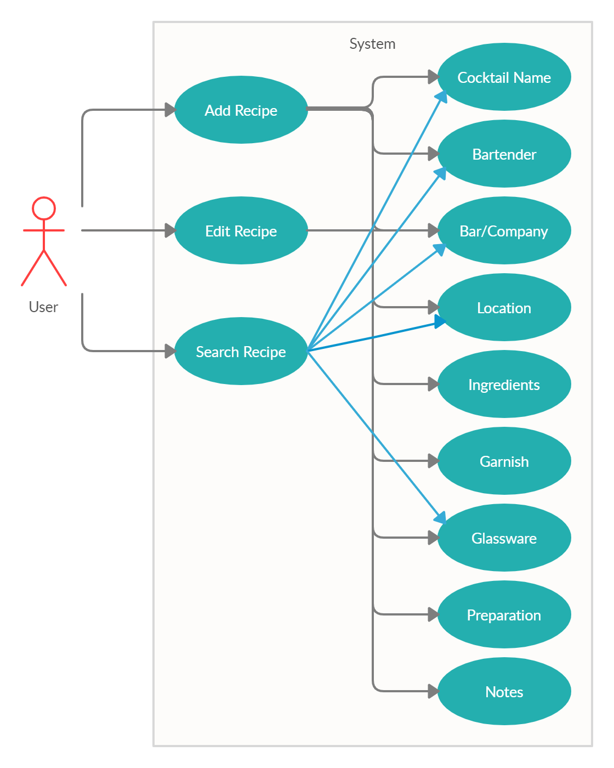
The user will access a wide list of cocktails
When the user selects the data-base, it will display a list of different types of cocktails
User can add, edit, and search through the different cocktails
User can search by cocktail names, bartender, bar/company, and the type of glassware

Slide 4
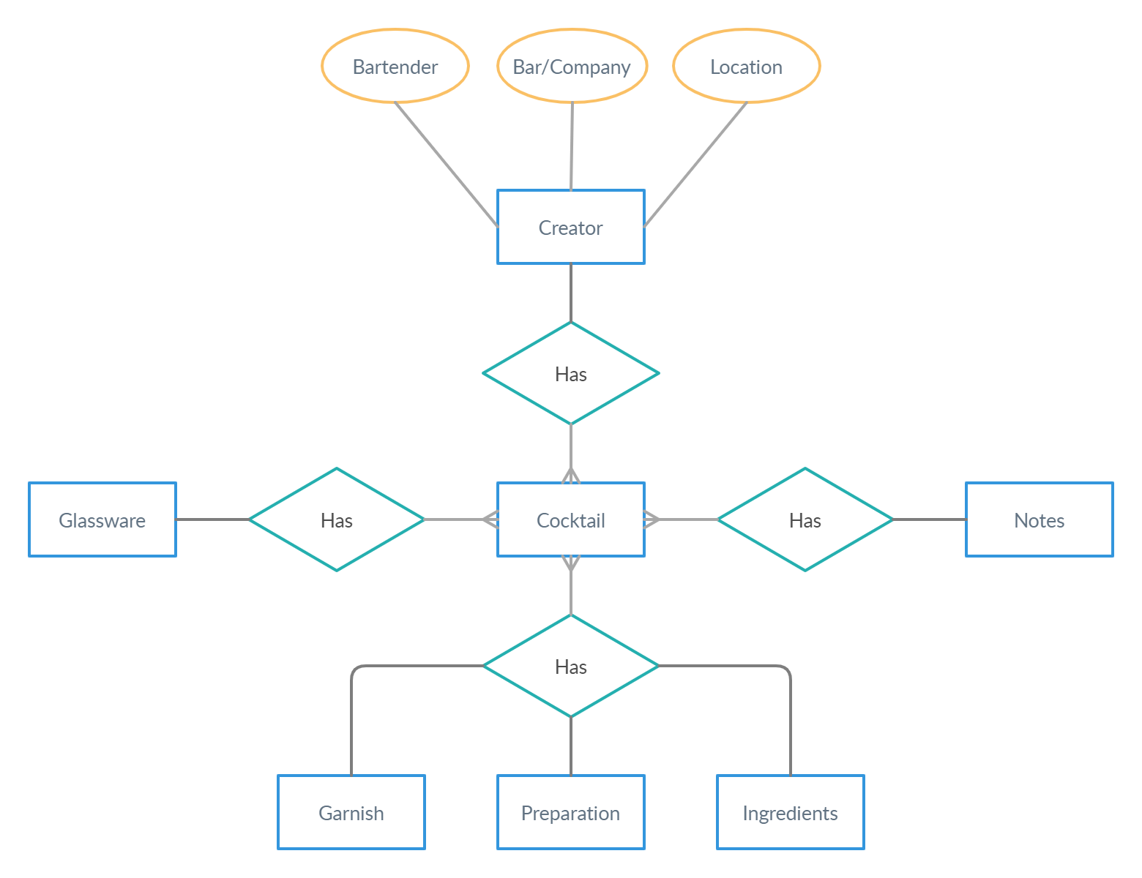
E/R Diagram
Name
Notes
Type
Recipe
Item
Recipe

Slide 5
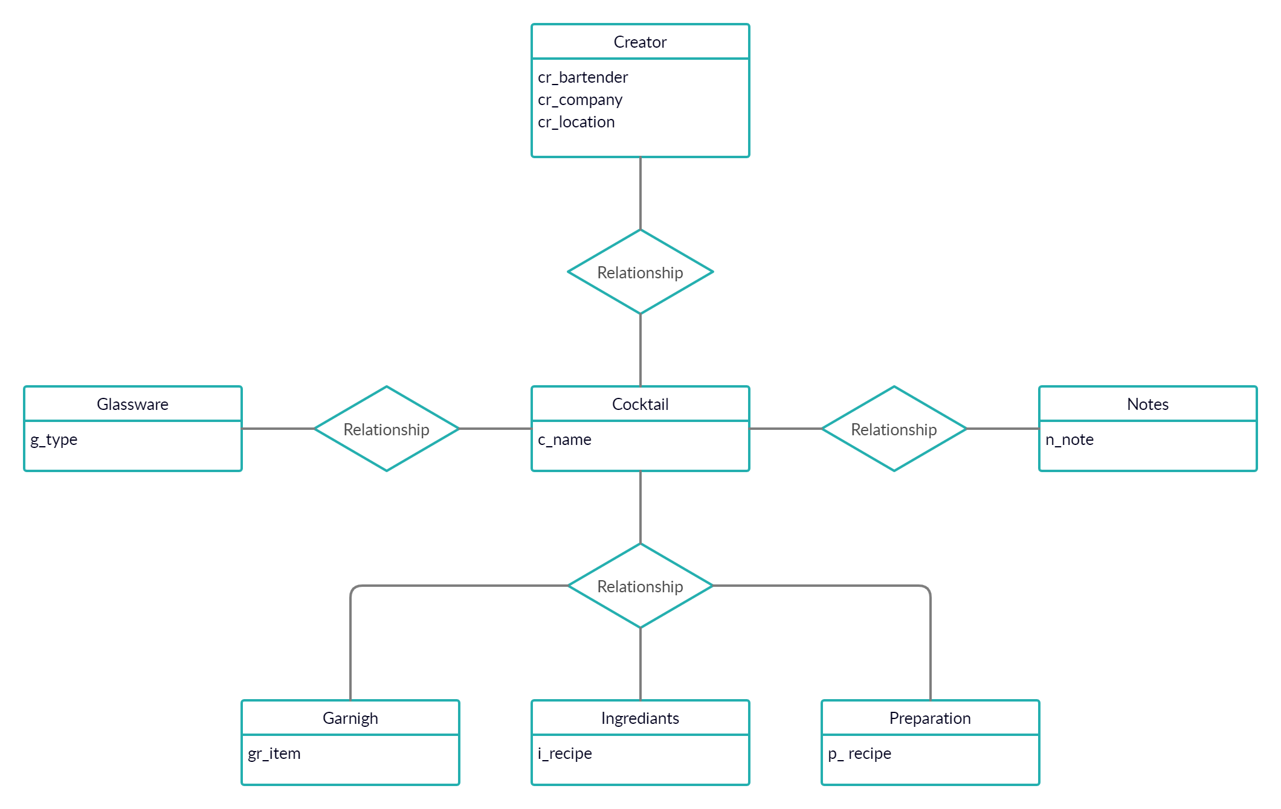
Relation Specification

Slide 6
Thank You
Questions?

